Slide 1
Alternative tests

Slide 2
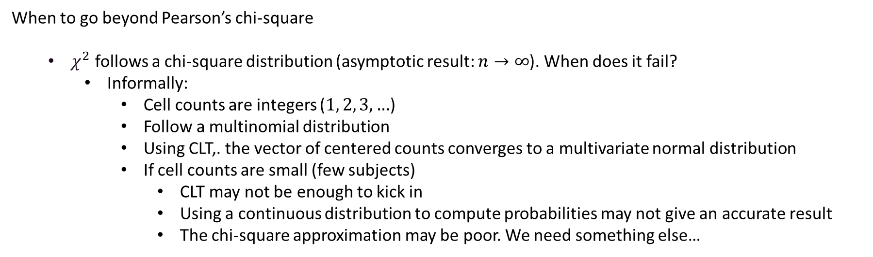
Beyond Pearson’s chi-square
When to go beyond Pearson’s chi-square
  $χ^{2}$ follows a chi-square distribution (asymptotic result: $n→∞$). When does it fail?
    Informally:
      Cell counts are integers ($1, 2, 3, …$)
      Follow a multinomial distribution
      Using CLT,. the vector of centered counts converges to a multivariate normal distribution
      If cell counts are small (few subjects)
        CLT may not be enough to kick in
        Using a continuous distribution to compute probabilities may not give an accurate result
        The chi-square approximation may be poor. We need something else…

Slide 3
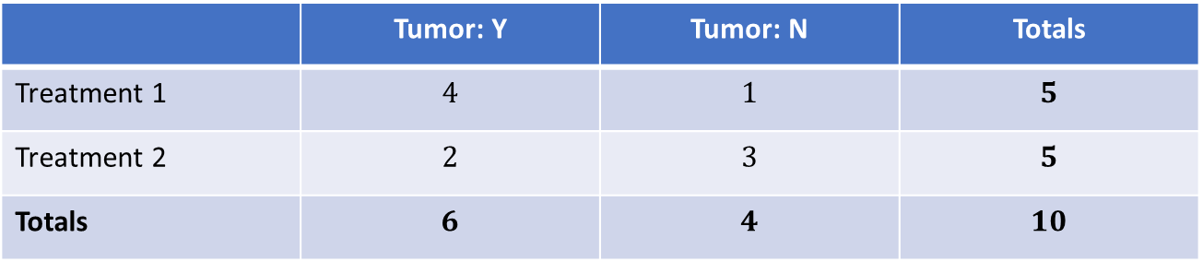
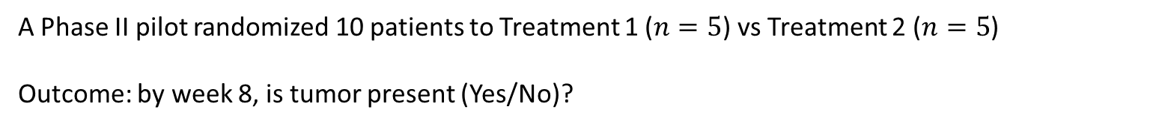
Example
A Phase II pilot randomized 10 patients to Treatment 1 ($n=5$) vs Treatment 2 ($n=5$)
Outcome: by week 8, is tumor present (Yes/No)?
 | Tumor: Y | Tumor: N | Totals
Treatment 1 | $$4$$ | $$1$$ | $$5$$
Treatment 2 | $$2$$ | $$3$$ | $$5$$
Totals | $$6$$ | $$4$$ | $$10$$
Is Treatment 2 associated with a higher tumor clearance (i.e., fewer “Tumor: Y”) than Treatment 1?

Slide 4
Fisher’s exact test
The Problem:
  Cells with very small counts
  Chi-square assumes smooth normal distribution
  Reality: Discrete counts {0, 1, 2, 3...} with heavy skewness
How do we get exact p-values instead of approximations?

Slide 5
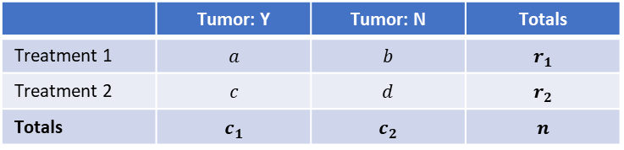
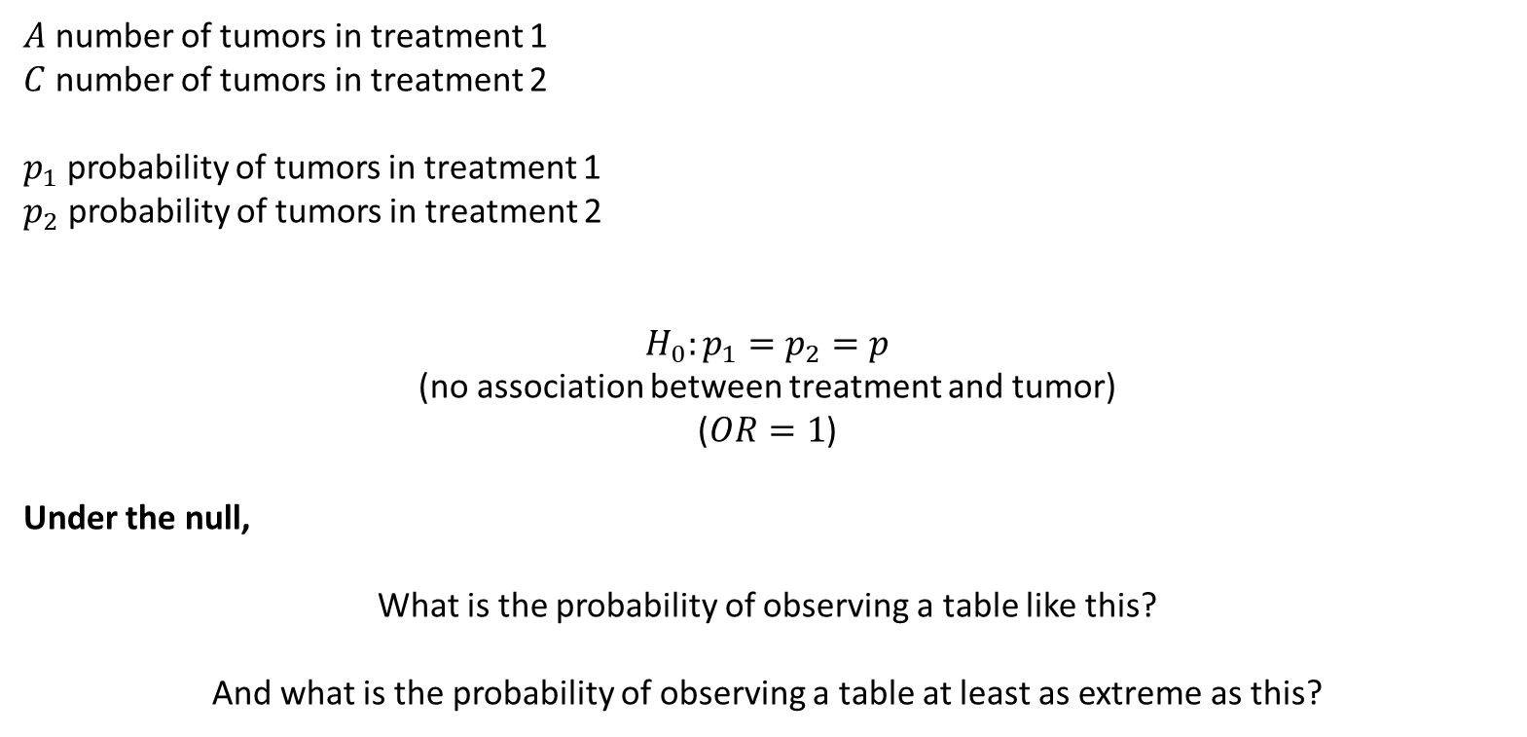
Fisher’s exact test
 | Tumor: Y | Tumor: N | Totals
Treatment 1 | $$a$$ | $$b$$ | $$r_{1}$$
Treatment 2 | $$c$$ | $$d$$ | $$r_{2}$$
Totals | $$c_{1}$$ | $$c_{2}$$ | $$n$$
$A$ number of tumors in treatment 1
$C$ number of tumors in treatment 2
$p_{1}$ probability of tumors in treatment 1
$p_{2}$ probability of tumors in treatment 2
$$H_{0}:p_{1}=p_{2}=p$$
(no association between treatment and tumor)
($OR=1$)
Under the null,
What is the probability of observing a table like this?
And what is the probability of observing a table at least as extreme as this?

Slide 6
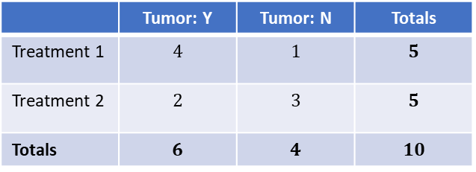
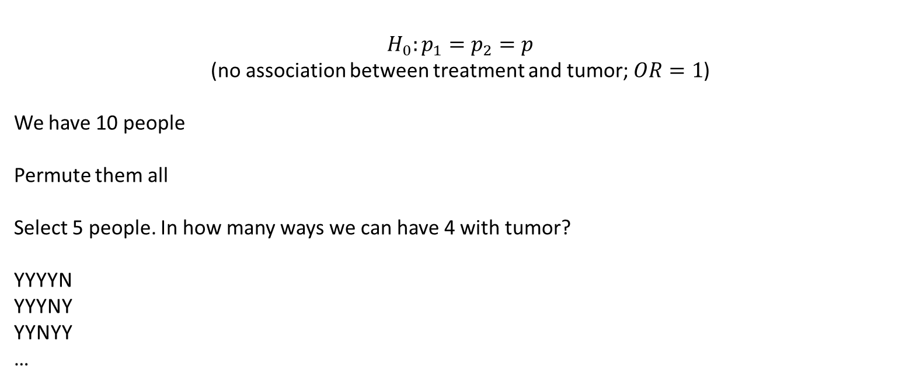
Fisher’s exact test
$$H_{0}:p_{1}=p_{2}=p$$
(no association between treatment and tumor; $OR=1$)
We have 10 people
Permute them all
Select 5 people. In how many ways we can have 4 with tumor?
YYYYN
YYYNY
YYNYY
…
 | Tumor: Y | Tumor: N | Totals
Treatment 1 | $$4$$ | $$1$$ | $$5$$
Treatment 2 | $$2$$ | $$3$$ | $$5$$
Totals | $$6$$ | $$4$$ | $$10$$

Slide 7
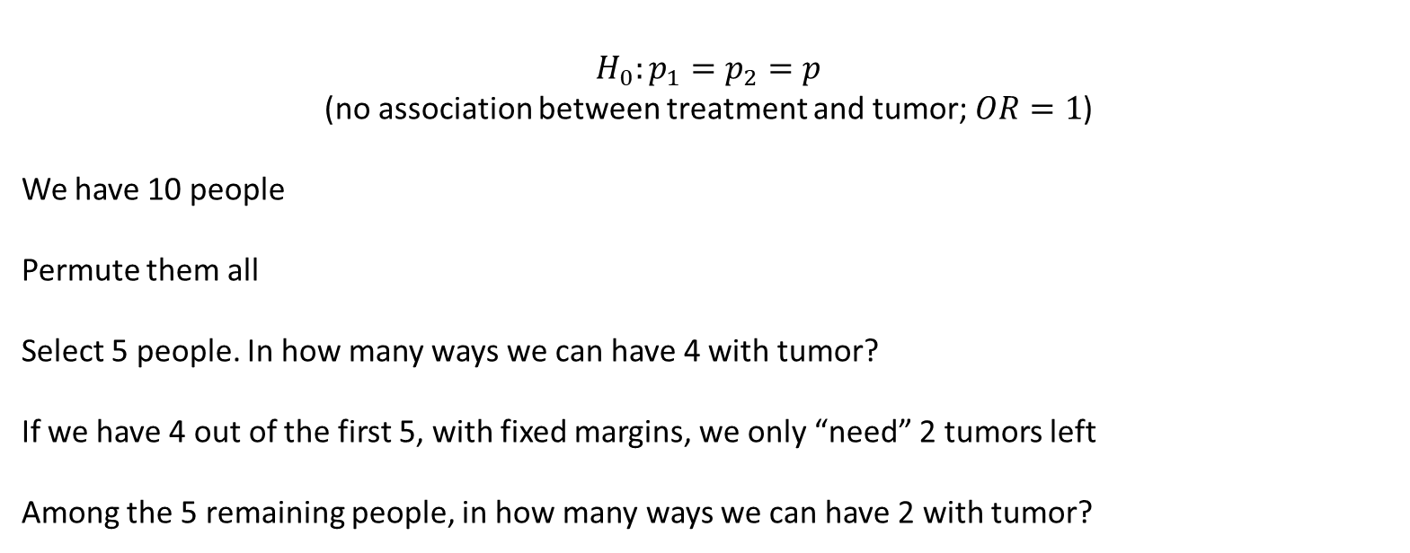
Fisher’s exact test
$$H_{0}:p_{1}=p_{2}=p$$
(no association between treatment and tumor; $OR=1$)
We have 10 people
Permute them all
Select 5 people. In how many ways we can have 4 with tumor?
If we have 4 out of the first 5, with fixed margins, we only “need” 2 tumors left
Among the 5 remaining people, in how many ways we can have 2 with tumor?
 | Tumor: Y | Tumor: N | Totals
Treatment 1 | $$4$$ | $$1$$ | $$5$$
Treatment 2 | $$2$$ | $$3$$ | $$5$$
Totals | $$6$$ | $$4$$ | $$10$$

Slide 8
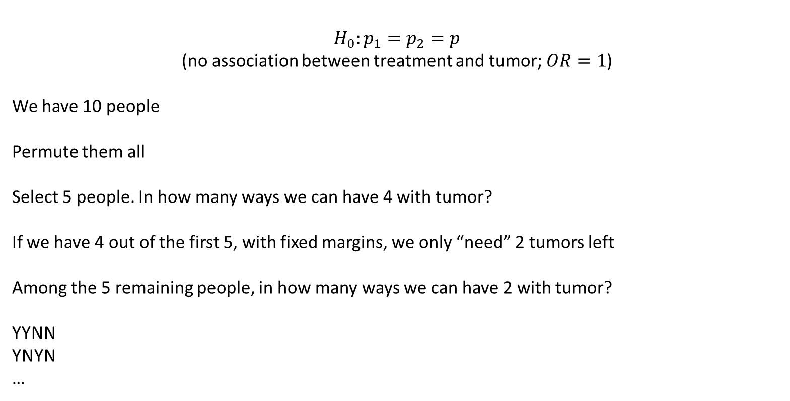
Fisher’s exact test
$$H_{0}:p_{1}=p_{2}=p$$
(no association between treatment and tumor; $OR=1$)
We have 10 people
Permute them all
Select 5 people. In how many ways we can have 4 with tumor?
If we have 4 out of the first 5, with fixed margins, we only “need” 2 tumors left
Among the 5 remaining people, in how many ways we can have 2 with tumor?
YYNN
YNYN
…
 | Tumor: Y | Tumor: N | Totals
Treatment 1 | $$4$$ | $$1$$ | $$5$$
Treatment 2 | $$2$$ | $$3$$ | $$5$$
Totals | $$6$$ | $$4$$ | $$10$$

Slide 9
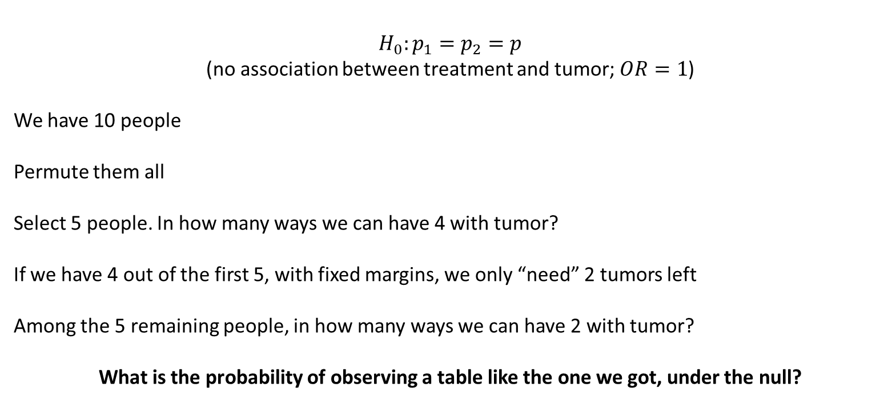
Fisher’s exact test
$$H_{0}:p_{1}=p_{2}=p$$
(no association between treatment and tumor; $OR=1$)
We have 10 people
Permute them all
Select 5 people. In how many ways we can have 4 with tumor?
If we have 4 out of the first 5, with fixed margins, we only “need” 2 tumors left
Among the 5 remaining people, in how many ways we can have 2 with tumor?
What is the probability of observing a table like the one we got, under the null?

Slide 10
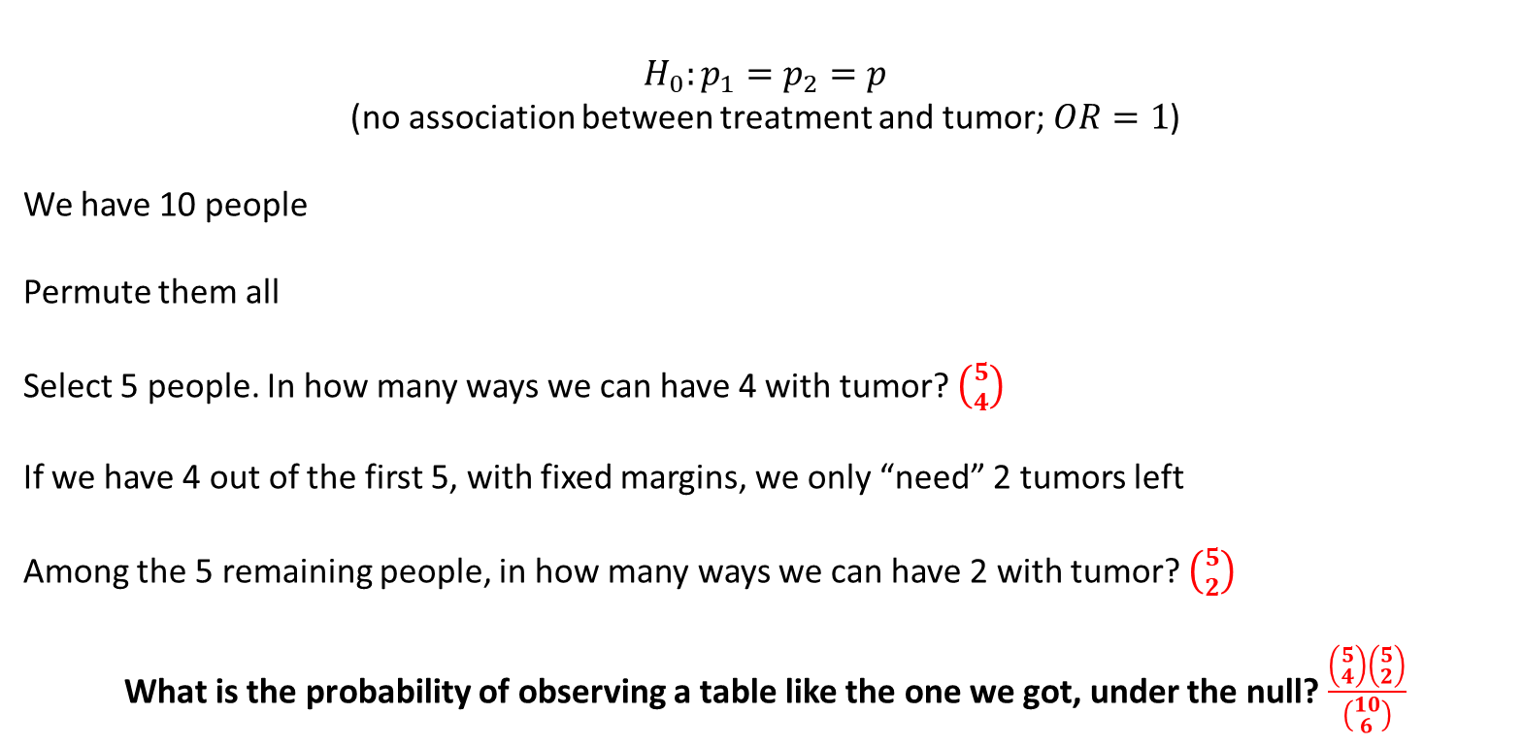
Fisher’s exact test
$$H_{0}:p_{1}=p_{2}=p$$
(no association between treatment and tumor; $OR=1$)
We have 10 people
Permute them all
Select 5 people. In how many ways we can have 4 with tumor? $\left({5 \atop 4}\right)$
If we have 4 out of the first 5, with fixed margins, we only “need” 2 tumors left
Among the 5 remaining people, in how many ways we can have 2 with tumor? $\left({5 \atop 2}\right)$
What is the probability of observing a table like the one we got, under the null? $\frac{\left({5 \atop 4}\right)\left({5 \atop 2}\right)}{\left({10 \atop 6}\right)}$

Slide 11

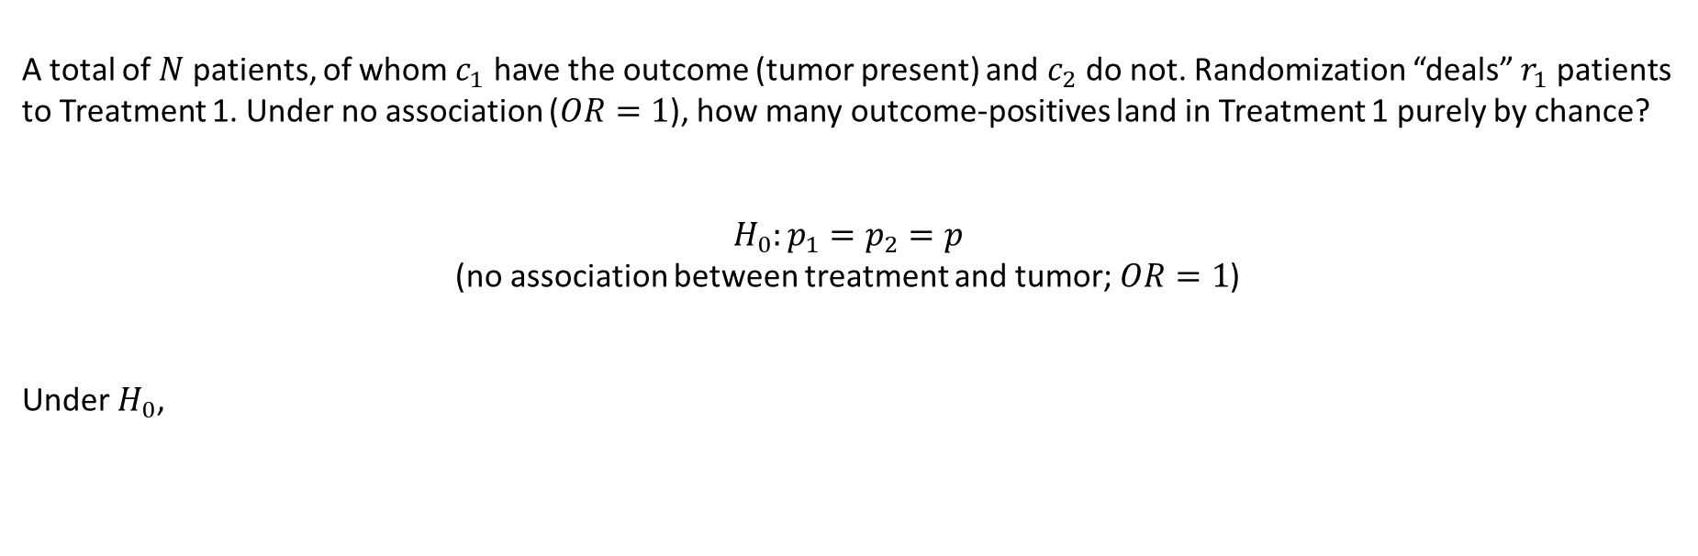
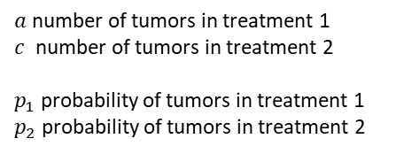
Fisher’s exact test
 | Tumor: Y | Tumor: N | Totals
Treatment 1 | $$a$$ | $$b$$ | $$r_{1}$$
Treatment 2 | $$c$$ | $$d$$ | $$r_{2}$$
Totals | $$c_{1}$$ | $$c_{2}$$ | $$n$$
A total of $N$ patients, of whom $c_{1}$ have the outcome (tumor present) and $c_{2}$ do not. Randomization “deals” $r_{1}$ patients to Treatment 1. Under no association ($OR=1$), how many outcome-positives land in Treatment 1 purely by chance?
$$H_{0}:p_{1}=p_{2}=p$$
(no association between treatment and tumor; $OR=1$)
Under $H_{0}$,
$$P\left(A=a | A+C=c_{1}\right)=\frac{\left({r_{1} \atop a}\right)\left({r_{2} \atop c_{1}−a}\right)}{\left({n \atop a+c}\right)}$$
$a$ number of tumors in treatment 1
$c$ number of tumors in treatment 2
$p_{1}$ probability of tumors in treatment 1
$p_{2}$ probability of tumors in treatment 2

Slide 12
Fisher’s exact test
We can use this idea to do hypothesis testing and calculate p-values
Calculate exact p-values
  Fixes both the row and the column totals
For example, we can
calculate whether treatment 2 is associated with higher tumor clearance

Slide 13
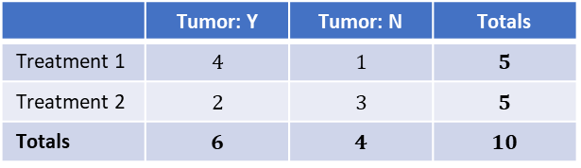
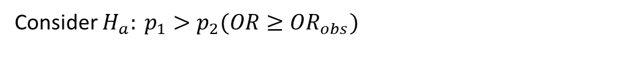
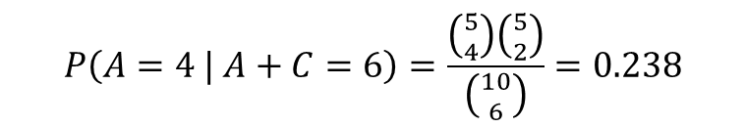
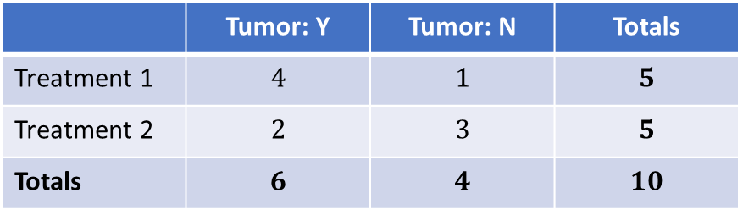
Fisher’s exact test
 | Tumor: Y | Tumor: N | Totals
Treatment 1 | $$4$$ | $$1$$ | $$5$$
Treatment 2 | $$2$$ | $$3$$ | $$5$$
Totals | $$6$$ | $$4$$ | $$10$$
Consider $H_{a}: p_{1}>p_{2}(OR≥OR_{obs})$
 | Tumor: Y | Tumor: N | Totals
Treatment 1 | $$4$$ | $$1$$ | $$5$$
Treatment 2 | $$2$$ | $$3$$ | $$5$$
Totals | $$6$$ | $$4$$ | $$10$$
$$P\left(A=4 | A+C=6\right)=\frac{\left({5 \atop 4}\right)\left({5 \atop 2}\right)}{\left({10 \atop 6}\right)}=0.238$$

Slide 14
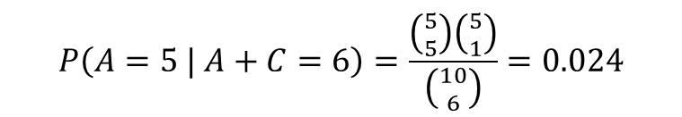
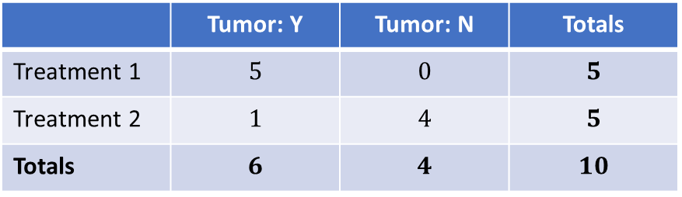
Fisher’s exact test
 | Tumor: Y | Tumor: N | Totals
Treatment 1 | $$4$$ | $$1$$ | $$5$$
Treatment 2 | $$2$$ | $$3$$ | $$5$$
Totals | $$6$$ | $$4$$ | $$10$$
Consider $H_{a}: p_{1}>p_{2}(OR≥OR_{obs})$
 | Tumor: Y | Tumor: N | Totals
Treatment 1 | $$4$$ | $$1$$ | $$5$$
Treatment 2 | $$2$$ | $$3$$ | $$5$$
Totals | $$6$$ | $$4$$ | $$10$$
$$P\left(A=4 | A+C=6\right)=\frac{\left({5 \atop 4}\right)\left({5 \atop 2}\right)}{\left({10 \atop 6}\right)}=0.238$$
 | Tumor: Y | Tumor: N | Totals
Treatment 1 | $$5$$ | $$0$$ | $$5$$
Treatment 2 | $$1$$ | $$4$$ | $$5$$
Totals | $$6$$ | $$4$$ | $$10$$
$$P\left(A=5 | A+C=6\right)=\frac{\left({5 \atop 5}\right)\left({5 \atop 1}\right)}{\left({10 \atop 6}\right)}=0.024$$

Slide 15
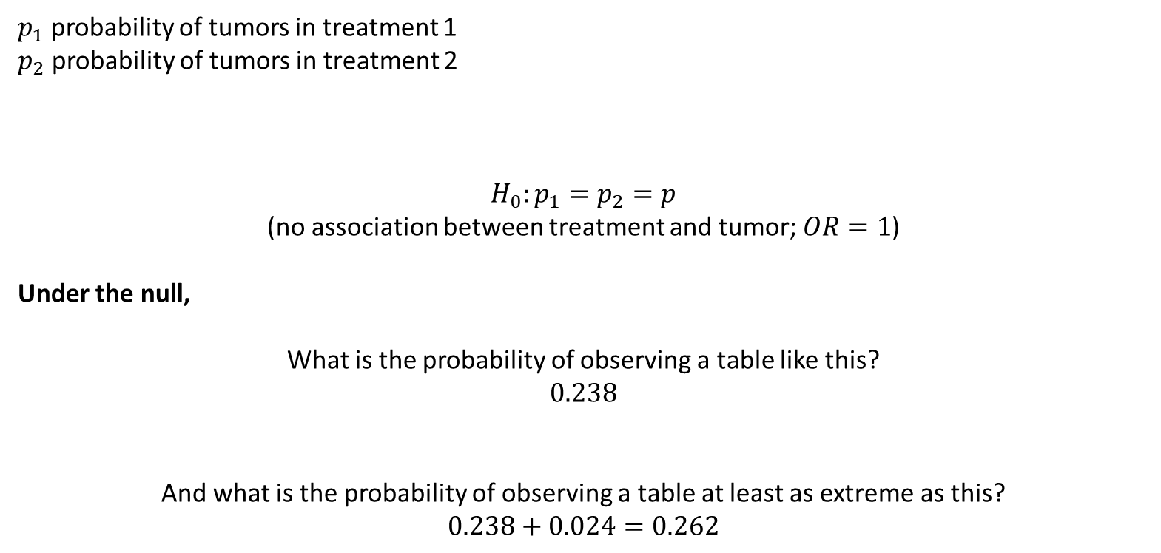
Fisher’s exact test
$p_{1}$ probability of tumors in treatment 1
$p_{2}$ probability of tumors in treatment 2
$$H_{0}:p_{1}=p_{2}=p$$
(no association between treatment and tumor; $OR=1$)
Under the null,
What is the probability of observing a table like this?
$$0.238$$
And what is the probability of observing a table at least as extreme as this?
$$0.238+0.024=0.262$$

Slide 16
Fisher’s exact test
df <- rbind(c(4, 1),
c(2, 3))
fisher.test(df, alternative = "greater")
##
## Fisher's Exact Test for Count Data
##
## data: df
## p-value = 0.2619
## alternative hypothesis: true odds ratio is greater than 1
## 95 percent confidence interval:
## 0.3152217 Inf
## sample estimates:
## odds ratio
## 4.918388

Slide 17
Fisher’s exact test
Notice that OR is a bit different. Why?

Slide 18
Fisher’s exact test
Notice that OR is a bit different. Why?
Conditioning on margins:
  Fisher’s exact test conditions on the row and column totals (margins)
  It computes a conditional maximum likelihood estimate (CMLE)
Given that we observed exactly 5 successes and 5 failures...
...and exactly 6 treated and 4 control patients...
what's the most likely OR that could produce this pattern?
Assumption: The marginal totals were predetermined by study design

Slide 19
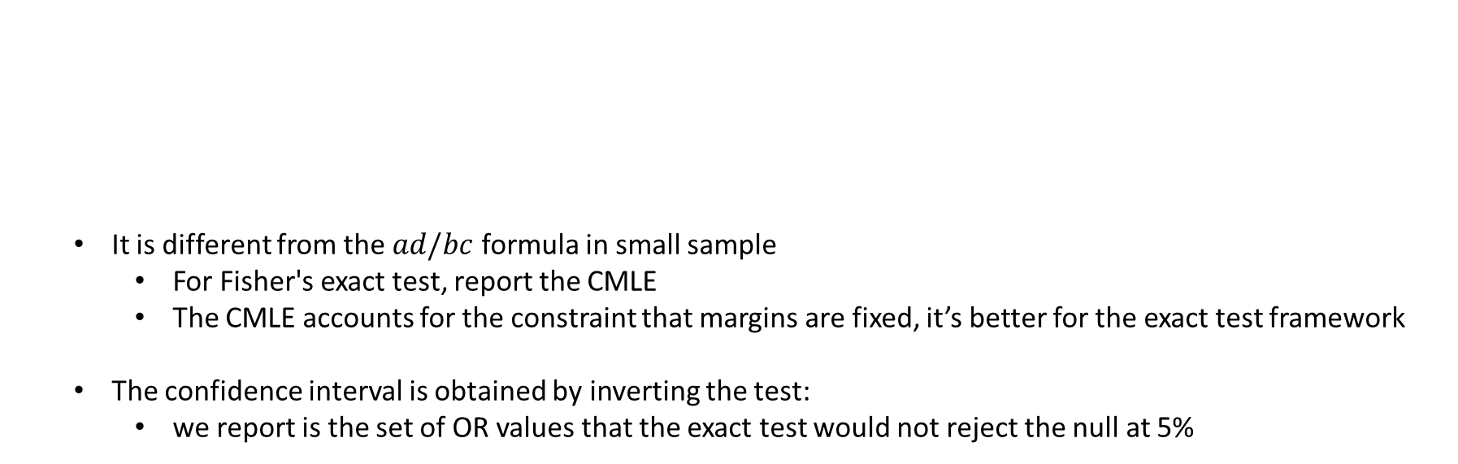
Fisher’s exact test
  It computes a conditional maximum likelihood estimate (CMLE)
  It is different from the $ad/bc$ formula in small sample
    For Fisher's exact test, report the CMLE
    The CMLE accounts for the constraint that margins are fixed, it’s better for the exact test framework
  The confidence interval is obtained by inverting the test:
    we report is the set of OR values that the exact test would not reject the null at 5%
Method | Formula | Assumption
Standard OR | ad/bc = (4×3)/(1×2) = 6.0 | Treats all cells as random
Fisher's Exact OR | CMLE = 4.92 | Treats margins as fixed

Slide 20
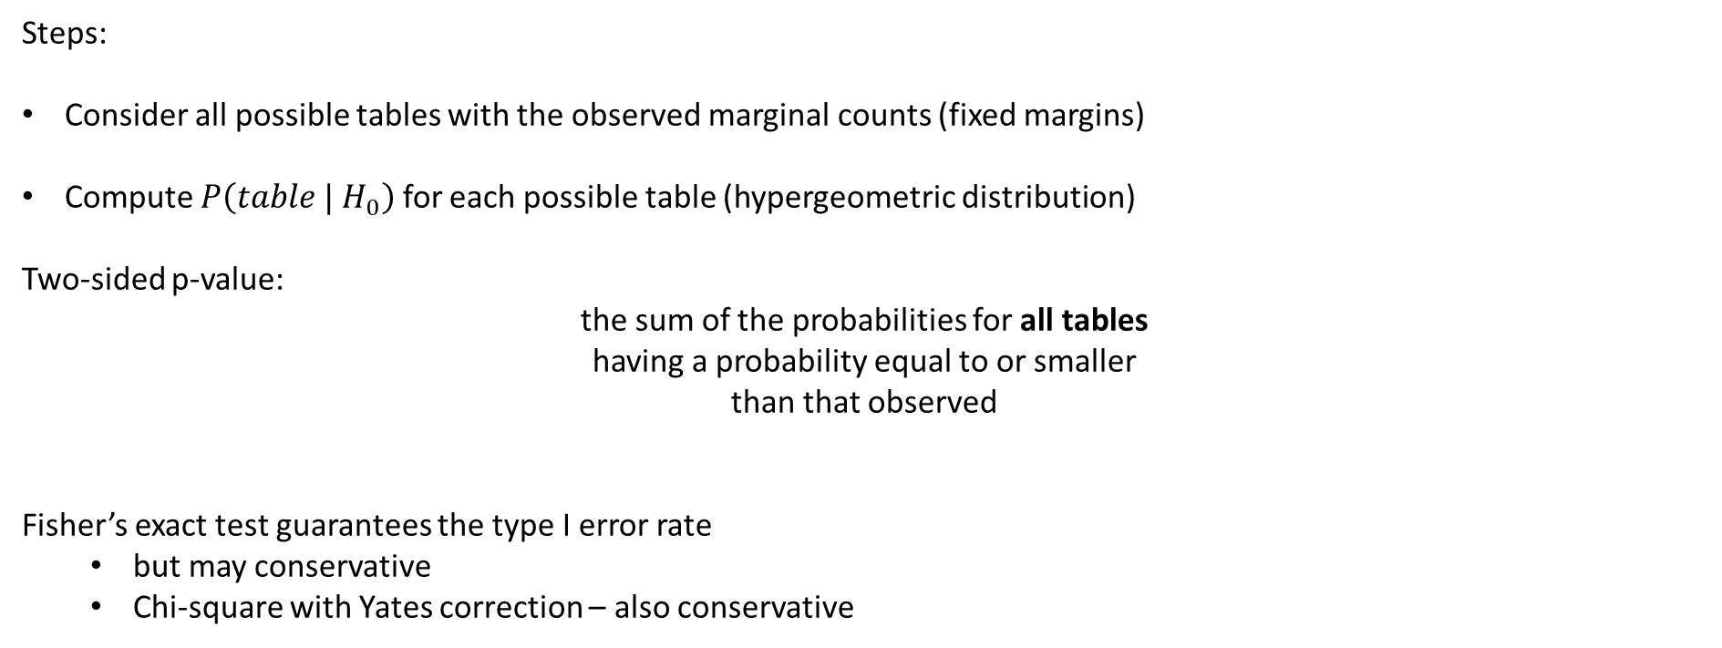
Fisher’s exact test
Steps:
Consider all possible tables with the observed marginal counts (fixed margins)
Compute $P\left(table | H_{0}\right)$ for each possible table (hypergeometric distribution)
Two-sided p-value:
the sum of the probabilities for all tables
having a probability equal to or smaller
than that observed
Fisher’s exact test guarantees the type I error rate
  but may conservative
  Chi-square with Yates correction – also conservative

Slide 21
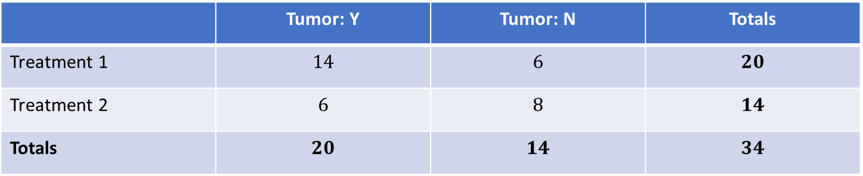
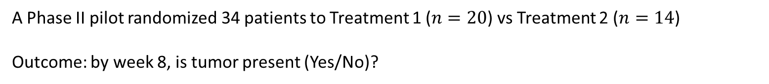
Example 2
A Phase II pilot randomized 34 patients to Treatment 1 ($n=20$) vs Treatment 2 ($n=14$)
Outcome: by week 8, is tumor present (Yes/No)?
 | Tumor: Y | Tumor: N | Totals
Treatment 1 | $$14$$ | $$6$$ | $$20$$
Treatment 2 | $$6$$ | $$8$$ | $$14$$
Totals | $$20$$ | $$14$$ | $$34$$
Is Treatment 2 associated with a higher tumor clearance (i.e., fewer “Tumor: Y”) than Treatment 1?

Slide 22
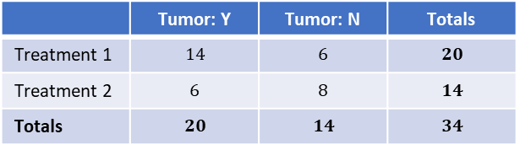
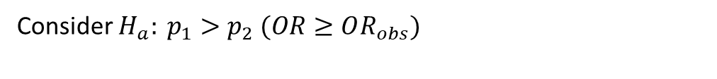
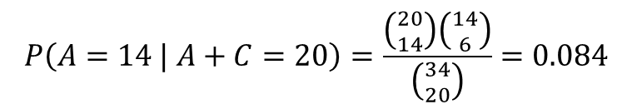
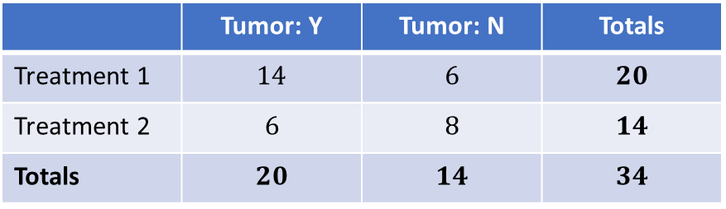
Fisher’s exact test
 | Tumor: Y | Tumor: N | Totals
Treatment 1 | $$14$$ | $$6$$ | $$20$$
Treatment 2 | $$6$$ | $$8$$ | $$14$$
Totals | $$20$$ | $$14$$ | $$34$$
Consider $H_{a}: p_{1}>p_{2} (OR≥OR_{obs})$
 | Tumor: Y | Tumor: N | Totals
Treatment 1 | $$14$$ | $$6$$ | $$20$$
Treatment 2 | $$6$$ | $$8$$ | $$14$$
Totals | $$20$$ | $$14$$ | $$34$$
$$P\left(A=14 | A+C=20\right)=\frac{\left({20 \atop 14}\right)\left({14 \atop 6}\right)}{\left({34 \atop 20}\right)}=0.084$$

Slide 23
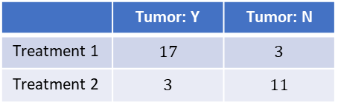
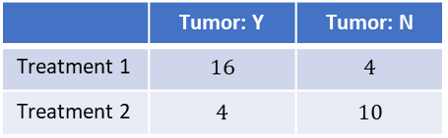
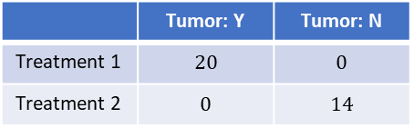
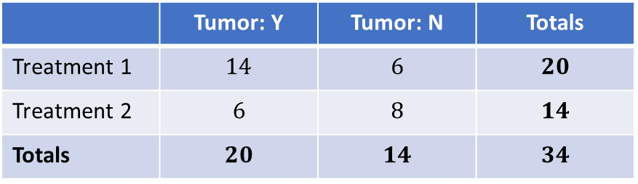
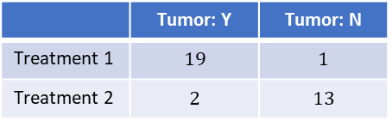
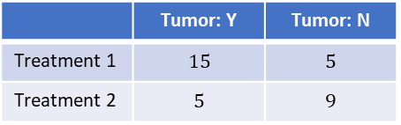
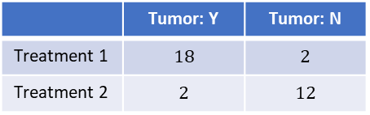
Fisher’s exact test
 | Tumor: Y | Tumor: N | Totals
Treatment 1 | $$14$$ | $$6$$ | $$20$$
Treatment 2 | $$6$$ | $$8$$ | $$14$$
Totals | $$20$$ | $$14$$ | $$34$$
Consider $H_{a}: p_{1}>p_{2} (OR≥OR_{obs})$
 | Tumor: Y | Tumor: N | Totals
Treatment 1 | $$14$$ | $$6$$ | $$20$$
Treatment 2 | $$6$$ | $$8$$ | $$14$$
Totals | $$20$$ | $$14$$ | $$34$$
$$P\left(A=14 | A+C=20\right)=\frac{\left({20 \atop 14}\right)\left({14 \atop 6}\right)}{\left({34 \atop 20}\right)}=0.084$$
 | Tumor: Y | Tumor: N
Treatment 1 | $$15$$ | $$5$$
Treatment 2 | $$5$$ | $$9$$
 | Tumor: Y | Tumor: N
Treatment 1 | $$16$$ | $$4$$
Treatment 2 | $$4$$ | $$10$$
 | Tumor: Y | Tumor: N
Treatment 1 | $$17$$ | $$3$$
Treatment 2 | $$3$$ | $$11$$
 | Tumor: Y | Tumor: N
Treatment 1 | $$18$$ | $$2$$
Treatment 2 | $$2$$ | $$12$$
 | Tumor: Y | Tumor: N
Treatment 1 | $$19$$ | $$1$$
Treatment 2 | $$2$$ | $$13$$
 | Tumor: Y | Tumor: N
Treatment 1 | $$20$$ | $$0$$
Treatment 2 | $$0$$ | $$14$$
sum(dhyper(x=14:20, m=20, n=14, k=20))
## [1] 0.1097129

Slide 24
Fisher’s exact test
df <- rbind(c(14, 6),
c(6, 8))
fisher.test(df, alternative = "greater")
##
## Fisher's Exact Test for Count Data
##
## data: df
## p-value = 0.1097
## alternative hypothesis: true odds ratio is greater than 1
## 95 percent confidence interval:
## 0.7526211 Inf
## sample estimates:
## odds ratio
## 3.002305

Slide 25
Fisher’s exact test
chisq.test(df)
##
## Pearson's Chi-squared test with Yates' continuity correction
##
## data: df
## X-squared = 1.5096, df = 1, p-value = 0.2192
fisher.test(df)
##
## Fisher's Exact Test for Count Data
##
## data: df
## p-value = 0.1627
## alternative hypothesis: true odds ratio is not equal to 1
## 95 percent confidence interval:
## 0.6067439 16.3813942
## sample estimates:
## odds ratio
## 3.002305
Same scientific question
Different inference methods
One is exact
The other is asymptotic

Slide 26
Resampling
Fisher's exact works great, but...
Table Size | Possible Tables | Computation Time
2×2 (n=20) | ~21 tables | Instant
2×2 (n=100) | ~101 tables | Fast
3×3 (n=100) | ~10,000+ tables | Slow
4×4 (n=200) | Millions of tables | Impractical
Solution:
Do not enumerate all tables → Resample/Permute
Same exact logic, computational faster
Monte Carlo approximation to exact p-values

Slide 27
Resampling
Why resampling for binary contingency tables?
  Small/sparse tables:
    exact tests are best, but Monte Carlo permutation can approximate exact p-values and scale to larger tables
  Effect sizes (RD, RR, OR):
    bootstrap provides robust CIs when parametric/normal approximations are not satisfied
    Complex test statistics; permutation is more flexible
  Permutation ≈ testing under exchangeability
  Bootstrap ≈ estimation of uncertainty (CIs) via resampling

Slide 28
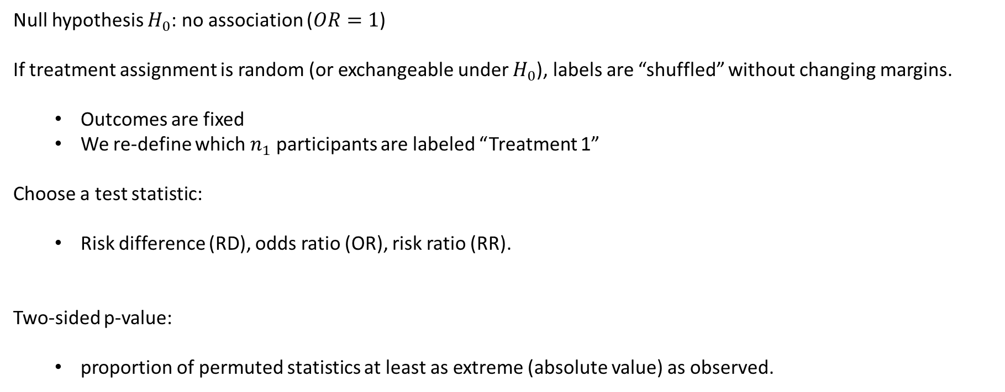
Permutation
Null hypothesis $H_{0}$: no association ($OR=1$)
If treatment assignment is random (or exchangeable under $H_{0}$), labels are “shuffled” without changing margins.
  Outcomes are fixed
  We re-define which $n_{1}$ participants are labeled “Treatment 1”
Choose a test statistic:
  Risk difference (RD), odds ratio (OR), risk ratio (RR).
Two-sided p-value:
  proportion of permuted statistics at least as extreme (absolute value) as observed.

Slide 29
Permutation
set.seed(1)
tab <- rbind(c(4, 1),
c(2, 3))
perm_p_rd <- function(tab, B = 10000) {
n1 <- sum(tab[1,])
n2 <- sum(tab[2,])
y <- c(rep(1, tab[1,1]), rep(0, tab[1,2]),
rep(1, tab[2,1]), rep(0, tab[2,2]))
g <- c(rep(1, n1), rep(2, n2))
obs <- mean(y[g == 1]) - mean(y[g == 2]) ## risk difference
stats <- replicate(B, {
gp <- sample(g) # permute labels; margins fixed
mean(y[gp == 1]) - mean(y[gp == 2]) ## risk difference
})
mean(abs(stats) >= abs(obs))
}
perm_p_rd(tab, B = 10000)
## [1] 0.5252

Slide 30
Bootstrap
What to bootstrap:
  Risk difference (RD)
  Risk ratio (RR) and odds ratio (OR)
    bootstrap on log scale
    back-transform
    add small continuity (e.g., +0.5 to each cell) when zeros appear
How to resample:
  Nonparametric bootstrap of individuals
  if group sizes are fixed by design, bootstrap within groups (stratified)

Slide 31
Bootstrap
set.seed(123)
tab <- rbind(c(4,1), c(2,3))
dat <- data.frame(
y = c(rep(1, tab[1,1]), rep(0, tab[1,2]),
rep(1, tab[2,1]), rep(0, tab[2,2])),
g = factor(c(rep("T1", sum(tab[1,])), rep("T2", sum(tab[2,]))))
)
obs_RD <- with(dat, mean(y[g=="T1"]) - mean(y[g=="T2"]))
boot_rd <- function(dat, R) {
rd <- rep(NA,R)
idx1 <- which(dat$g=="T1"); idx2 <- which(dat$g=="T2")
for (r in seq_len(R)) {
s1 <- sample(idx1, length(idx1), replace = TRUE)
s2 <- sample(idx2, length(idx2), replace = TRUE)
d <- dat[c(s1, s2), ]
rd[r] <- with(d, mean(y[g=="T1"]) - mean(y[g=="T2"]))
}
rd
}
rd_boot <- boot_rd(dat, R = 999)
quantile(rd_boot, c(0.025, 0.975))
## 2.5% 97.5%
## -0.2 1.0

Slide 32
Dependent data
All our methods so far assume:
Each observation is independent
But what if...
Same patients measured before/after treatment?
Matched pairs (twins, siblings)?
Left eye vs right eye in same person?

Slide 33
Dependent data
Before/After Study: Depression Treatment
  50 patients with depression
  Measure severity before treatment (Yes/No)
  Measure severity after treatment (Yes/No)
Why regular chi-square fails:
  Same person appears twice in the table
  Observations are correlated, not independent
  Chi-square assumes independence

Slide 34
Dependent data
Dependent binary data can arise from
  Measuring a response at two occasions
  Matching on case status in a retrospective study
  Matching on exposure status in a prospective or cross-sectional study
The pairs on binary observations are dependent, so our existing methods do not apply
We need different methods for paired data

Slide 35
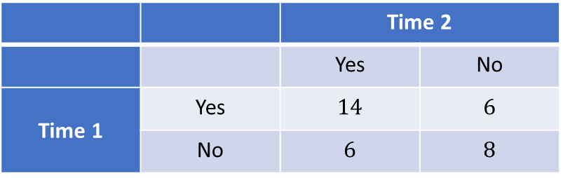
Example
Compare a new self-collected HPV test
vs
clinician-collected HPV test on the same women (Yes/No HPV detected)
 |  | Time 2
 |  | Yes | No
Time 1 | Yes | $$14$$ | $$6$$
 | No | $$6$$ | $$8$$
What happens when our assumption of independence is violated

Slide 36
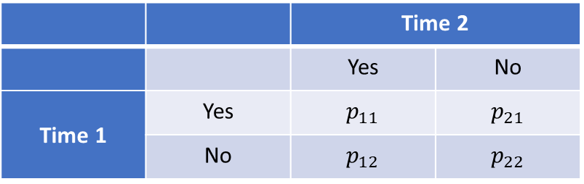

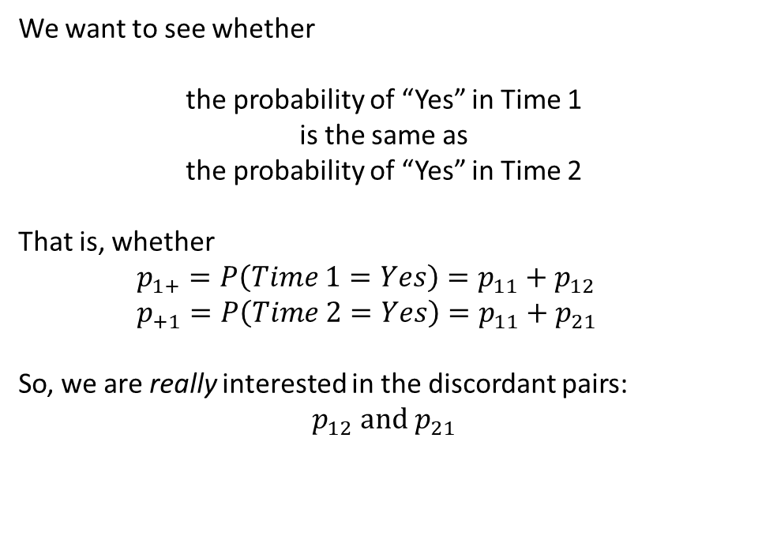
McNemar test
 |  | Time 2
 |  | Yes | No
Time 1 | Yes | $$n_{11}$$ | $$n_{21}$$
 | No | $$n_{12}$$ | $$n_{22}$$
We want to see whether
the probability of “Yes” in Time 1
is the same as
the probability of “Yes” in Time 2
That is, whether
    $$p_{1+}=P\left(Time 1=Yes\right)=p_{11}+p_{12}$$
    $$p_{+1}=P\left(Time 2=Yes\right)=p_{11}+p_{21}$$
So, we are really interested in the discordant pairs:
$$p_{12} and p_{21}$$
 |  | Time 2
 |  | Yes | No
Time 1 | Yes | $$p_{11}$$ | $$p_{21}$$
 | No | $$p_{12}$$ | $$p_{22}$$
McNemar's test: Analyzes only the discordant pairs

Slide 37


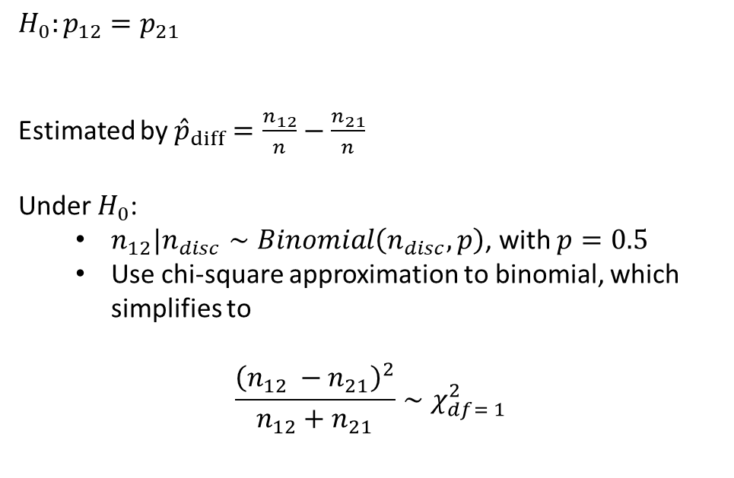
McNemar test
 |  | Time 2
 |  | Yes | No
Time 1 | Yes | $$n_{11}$$ | $$n_{21}$$
 | No | $$n_{12}$$ | $$n_{22}$$
Transitions from Yes → No
are equally likely
as transitions from No → Yes
$$H_{0}:p_{12}=p_{21}$$
Estimated by ${\hat{p}}_{diff}=\frac{n_{12}}{n}−\frac{n_{21}}{n}$
Under $H_{0}$:
  $n_{12}|n_{disc}∼Binomial\left(n_{disc},p\right)$, with $p=0.5$
  Use chi-square approximation to binomial, which simplifies to
$$\frac{{\left(n_{12} −n_{21}\right)}^{2}}{n_{12}+n_{21}}∼χ_{df= 1}^{2}$$
 |  | Time 2
 |  | Yes | No
Time 1 | Yes | $$p_{11}$$ | $$p_{21}$$
 | No | $$p_{12}$$ | $$p_{22}$$
$$n_{disc}=n_{12}+n_{21}$$
$$χ^{2}=\frac{{\left(O_{12} − E_{12}\right)}^{2}}{E_{12}}+\frac{{\left(O_{21} − E_{21}\right)}^{2}}{E_{21}}$$

Slide 38
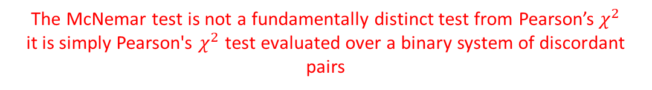
McNemar test
The McNemar test is not a fundamentally distinct test from Pearson’s$χ^{2}$
it is simply Pearson's $χ^{2}$ test evaluated over a binary system of discordant pairs
 |  | Time 2
 |  | Yes | No
Time 1 | Yes | $$n_{11}$$ | $$n_{21}$$
 | No | $$n_{12}$$ | $$n_{22}$$
Transitions from Yes → No
are equally likely
as transitions from No → Yes
$$H_{0}:p_{12}=p_{21}$$
Estimated by ${\hat{p}}_{diff}=\frac{n_{12}}{n}−\frac{n_{21}}{n}$
Under $H_{0}$:
  $n_{12}|n_{disc}∼Binomial\left(n_{disc},p\right)$, with $p=0.5$
  Use chi-square approximation to binomial, which simplifies to
$$\frac{{\left(n_{12} −n_{21}\right)}^{2}}{n_{12}+n_{21}}∼χ_{df= 1}^{2}$$
 |  | Time 2
 |  | Yes | No
Time 1 | Yes | $$p_{11}$$ | $$p_{21}$$
 | No | $$p_{12}$$ | $$p_{22}$$
$$n_{disc}=n_{12}+n_{21}$$
$$χ^{2}=\frac{{\left(O_{12} − E_{12}\right)}^{2}}{E_{12}}+\frac{{\left(O_{21} − E_{21}\right)}^{2}}{E_{21}}$$

Slide 39

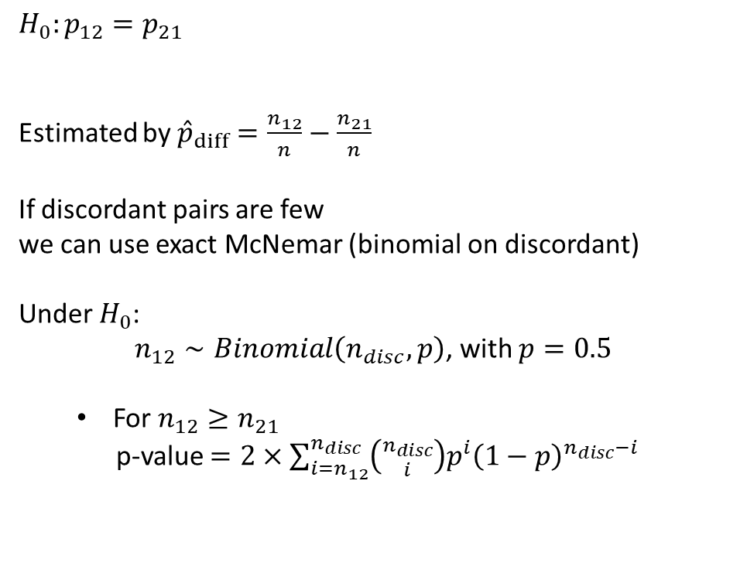
McNemar test
The McNemar test is not a fundamentally distinct test from Pearson’s$χ^{2}$
it is simply Pearson's $χ^{2}$ test evaluated over a binary system of discordant pairs
 |  | Time 2
 |  | Yes | No
Time 1 | Yes | $$n_{11}$$ | $$n_{21}$$
 | No | $$n_{12}$$ | $$n_{22}$$
Transitions from Yes → No
are equally likely
as transitions from No → Yes
$$H_{0}:p_{12}=p_{21}$$
Estimated by ${\hat{p}}_{diff}=\frac{n_{12}}{n}−\frac{n_{21}}{n}$
If discordant pairs are few
we can use exact McNemar (binomial on discordant)
Under $H_{0}$:
$n_{12}∼Binomial\left(n_{disc},p\right)$, with $p=0.5$
  For $n_{12}≥n_{21}$
p-value $=2×\sum_{i=n_{12}}^{n_{disc}}{\left({n_{disc} \atop i}\right)p^{i}{\left(1−p\right)}^{n_{disc}−i}}$
 |  | Time 2
 |  | Yes | No
Time 1 | Yes | $$p_{11}$$ | $$p_{21}$$
 | No | $$p_{12}$$ | $$p_{22}$$
$$n_{disc}=n_{12}+n_{21}$$

Slide 40
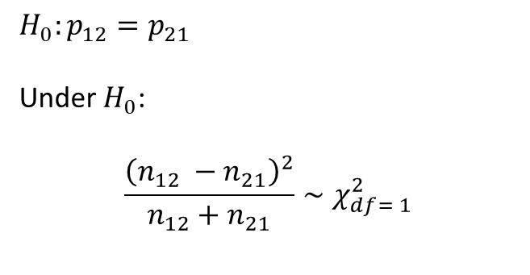
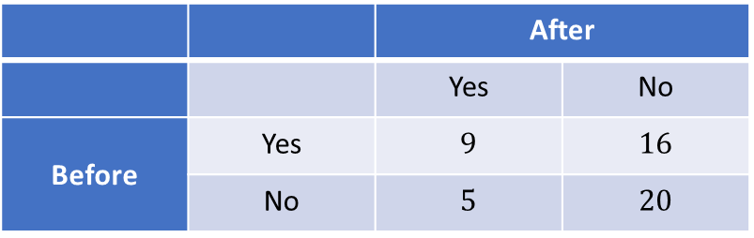
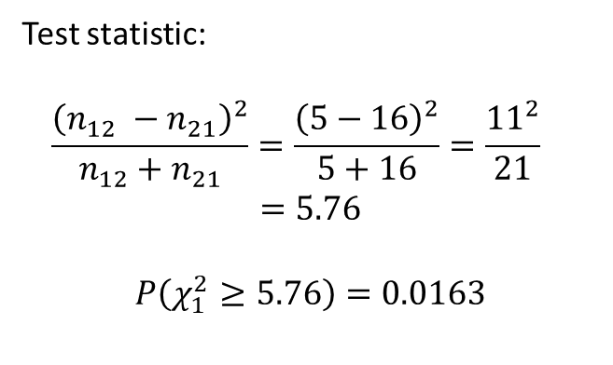
McNemar test
 |  | After
 |  | Yes | No
Before | Yes | $$9$$ | $$16$$
 | No | $$5$$ | $$20$$
$$H_{0}:p_{12}=p_{21}$$
Under $H_{0}$:
$$\frac{{\left(n_{12} −n_{21}\right)}^{2}}{n_{12}+n_{21}}∼χ_{df= 1}^{2}$$
Test statistic:
$$\frac{{\left(n_{12} −n_{21}\right)}^{2}}{n_{12}+n_{21}}=\frac{{\left(5−16\right)}^{2}}{5+16}=\frac{{11}^{2}}{21} =5.76$$
$$P\left(χ_{1}^{2}≥5.76\right)=0.0163$$

Slide 41
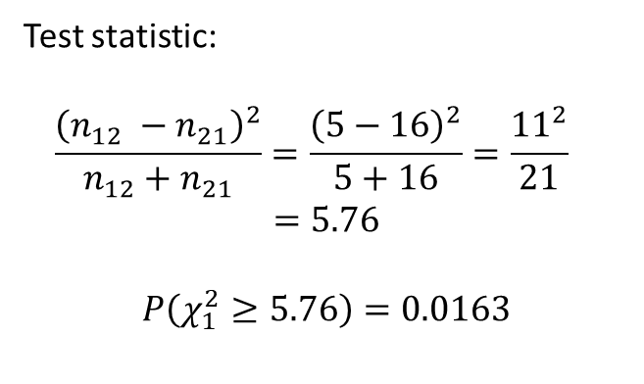
McNemar test
 |  | After
 |  | Yes | No
Before | Yes | $$9$$ | $$16$$
 | No | $$5$$ | $$20$$
Test statistic:
$$\frac{{\left(n_{12} −n_{21}\right)}^{2}}{n_{12}+n_{21}}=\frac{{\left(5−16\right)}^{2}}{5+16}=\frac{{11}^{2}}{21} =5.76$$
$$P\left(χ_{1}^{2}≥5.76\right)=0.0163$$
df <- rbind(c(9, 16),
c(5, 20))
mcnemar.test(df, correct = FALSE)
##
## McNemar's Chi-squared test
##
## data: df
## McNemar's chi-squared = 5.7619, df = 1, p-value = 0.01638

Slide 42
Overall
Data Type | Sample Size | Counts | Method
Independent | Large | All ≥ 5 | Chi-square test
Independent | Small | Some < 5 | Fisher's exact test
Independent | Any | Any | Permutation test
Paired/Matched | Large | Discordant ≥ 5 | McNemar's chi-square
Paired/Matched | Small | Discordant < 5 | Exact McNemar's

Slide 43
Overall
When to go beyond Pearson’s chi-square:
  Small/sparse expected counts
  dependent designs (paired/clustered)
Fisher’s exact test:
  Conditions on fixed margins
    uses hypergeometric probabilities
    controls type I error
  Report odds ratio with exact 95% CI
  CMLE odds ratio can differ from ad/bc in small samples
  Two-sided exact p-values are typically conservative

Slide 44
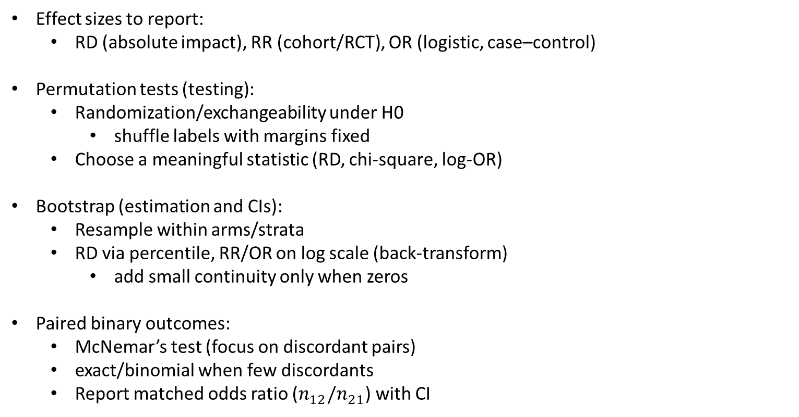
Overall
Effect sizes to report:
  RD (absolute impact), RR (cohort/RCT), OR (logistic, case–control)
Permutation tests (testing):
  Randomization/exchangeability under H0
    shuffle labels with margins fixed
  Choose a meaningful statistic (RD, chi-square, log-OR)
Bootstrap (estimation and CIs):
  Resample within arms/strata
  RD via percentile, RR/OR on log scale (back-transform)
    add small continuity only when zeros
Paired binary outcomes:
  McNemar’s test (focus on discordant pairs)
  exact/binomial when few discordants
  Report matched odds ratio ($n_{12}/n_{21}$) with CI

Slide 45
THANK YOU!

